Slide 1
Recommender System
By Samriddh Lakhmani

Slide 2
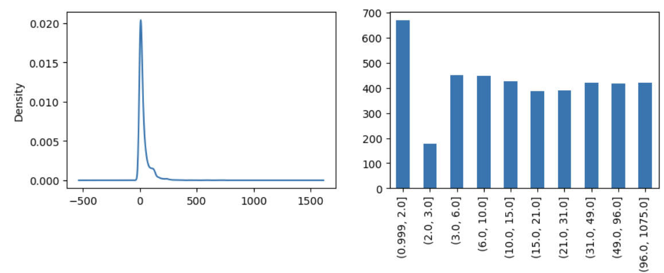
Steps of the Process
Each user had multiple engagements with the same poll, unnecessary interactions were given a weight of 0 while others were given appropriate weights
Seven Algorithms :
Content Based
Collaborative Filtering (CF) - User Basis
Collaborative Filtering - Item Basis
SVD implementation
CF - User Basis + Cold Start Resolution
Trending basis demographics
Hybrid Approach
Pre-processing
user_poll
engagement
EDA performed
Multiple Algorithms
Final Comparison
App Events,
User Properties
Poll Features,
Were separated and saved
EDA was performed to evaluate the type of users engaging with the platform
All models were compared and a comparison table was created

Slide 3
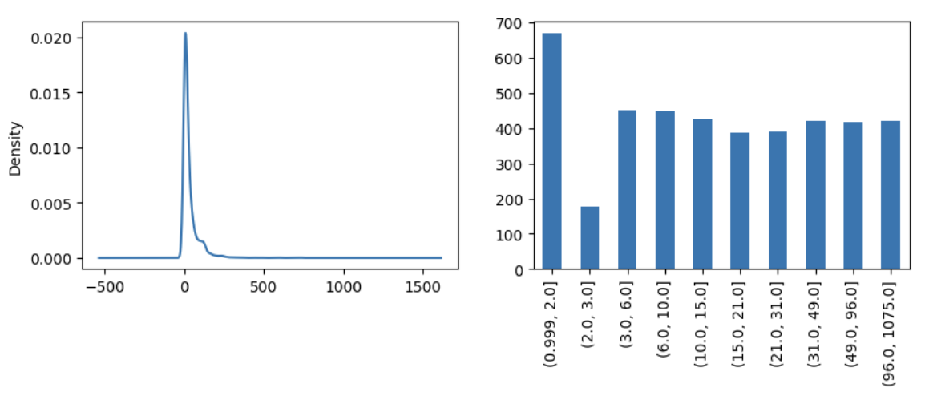
Exploratory Data Analysis
More than 50% users answer more than 75% polls they read
90% users share < 25% of the polls they read

Slide 4
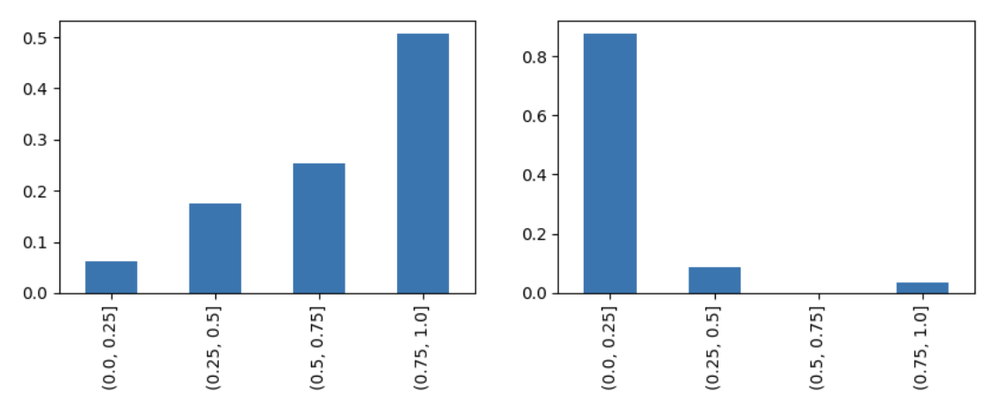
Exploratory Data Analysis
A large set of users drop off before reading 3 polls. After that drop off is consistent.

Slide 5
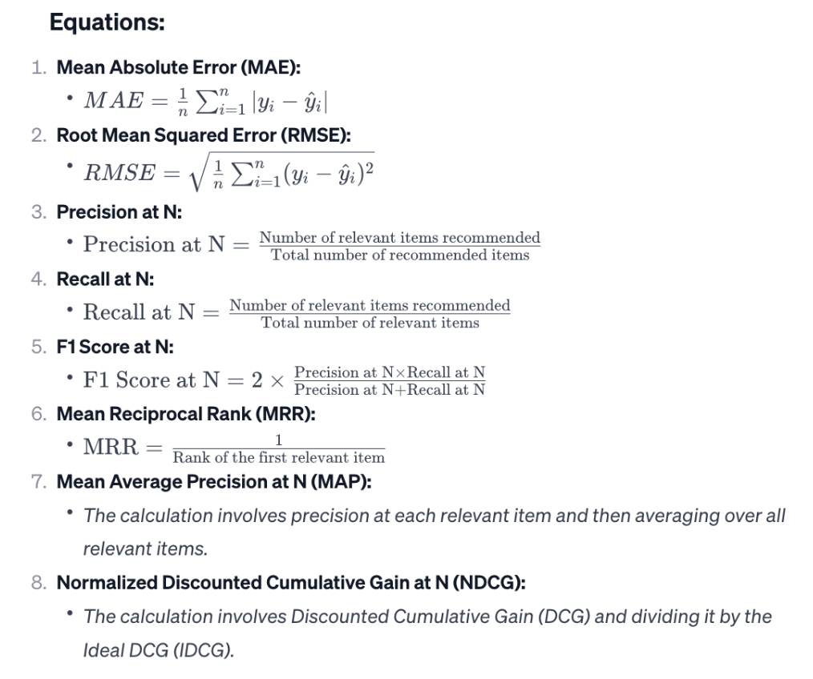
Metric Setup - For Model Performance
The following metrics were defined to compare the recommendation performance of each of the models.

Slide 6
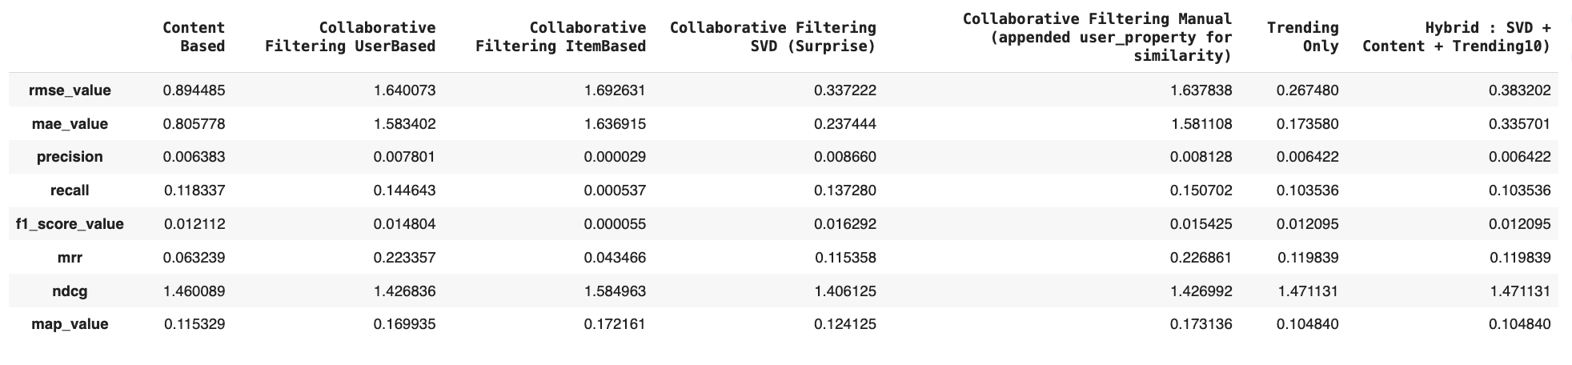
Final Results
Based on NDCG and Precision the Collaborative filtering performed along with matrix factorization method SVD performed the best

Slide 7
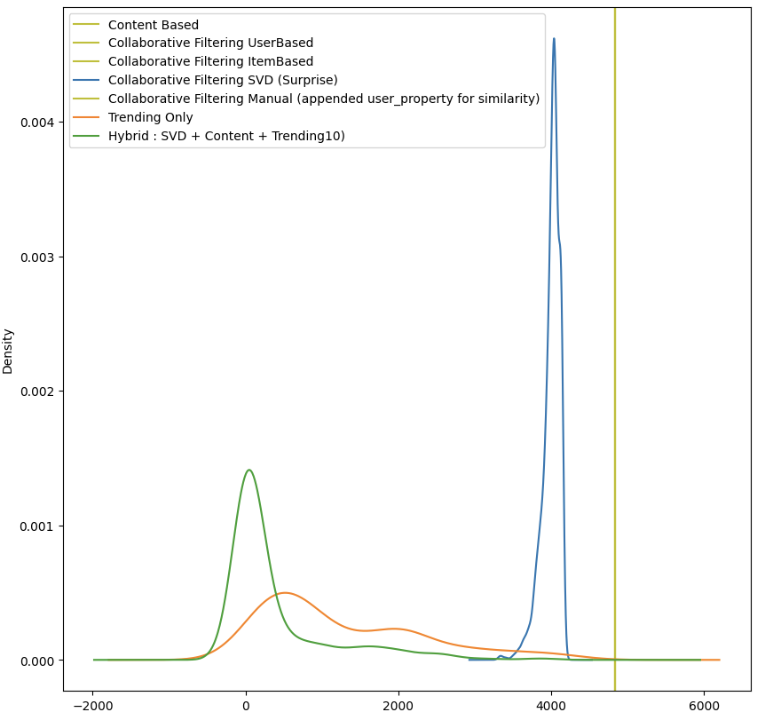
Final Results
Since SVD metrics are the best performing metrics
And other models recommend same polls to everyone
We shall use SVD for recommendation

